Slide 1
Alexander-Sadiku
Fundamentals of Electric Circuits
Chapter 12
Three-Phase Circuit
Copyright © The McGraw-Hill Companies, Inc. Permission required for reproduction or display.

Slide 2
Three-Phase Circuits
Chapter 12
12.1 What is a Three-Phase Circuit?
12.2 Balance Three-Phase Voltages
12.3 Balance Three-Phase Connection
12.4 Power in a Balanced System
12.5 Unbalanced Three-Phase Systems
12.6 Application – Residential Wiring

Slide 3
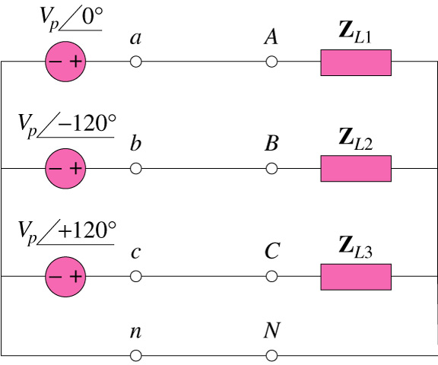
12.1 What is a Three-Phase Circuit?(1)
It is a system produced by a generator consisting of three sources having the same amplitude and frequency but out of phase with each other by 120°.
Three sources with 120° out
of phase
Four wired system

Slide 4
12.1 What is a Three-Phase Circuit?(2)
  Advantages:
    Most of the electric power is generated and distributed in three-phase.
    The instantaneous power in a three-phase system can be constant.
    For the same amount of power, the three-phase system is more economical that the single-phase.
    In fact, the amount of wire required for a three-phase system is less than that required for an equivalent single-phase system.

Slide 5
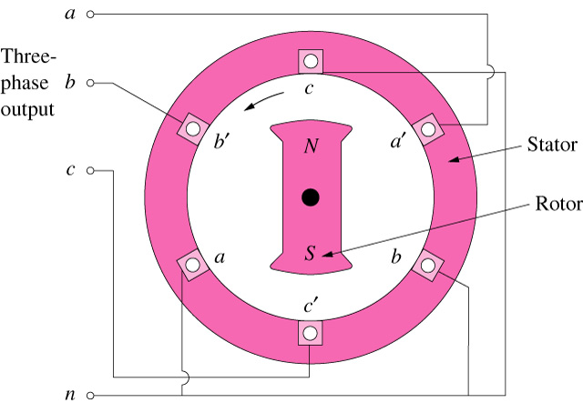
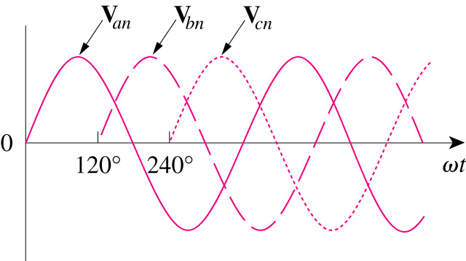
12.2 Balance Three-Phase Voltages (1)
Three phase voltages are often produced with a three-phase ac generator.
A three-phase generator consists of a rotating magnet (rotor) surrounded by a stationary winding (stator).
A three-phase generator
The generated voltages

Slide 6
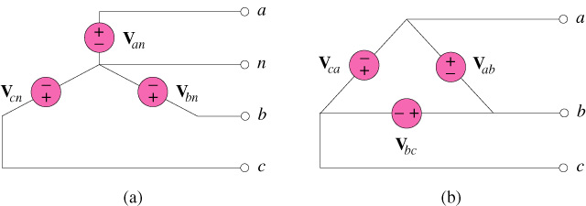
12.2 Balance Three-Phase Voltages (2)
Two possible configurations:
Three-phase voltage sources: (a) Y-connected ; (b) Δ-connected

Slide 7
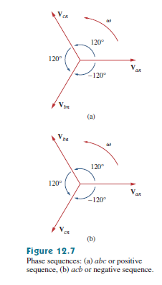
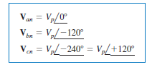
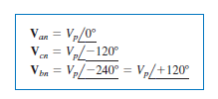
12.2 Balance Three-Phase Voltages (3)
Balanced phase voltages are equal in magnitude and are out of phase with each other by 120°.

Slide 8
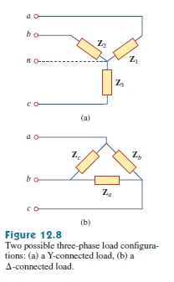

12.2 Balance Three-Phase Voltages (4)
A balanced load is one in which the phase impedances are equal in magnitude and in phase

Slide 9
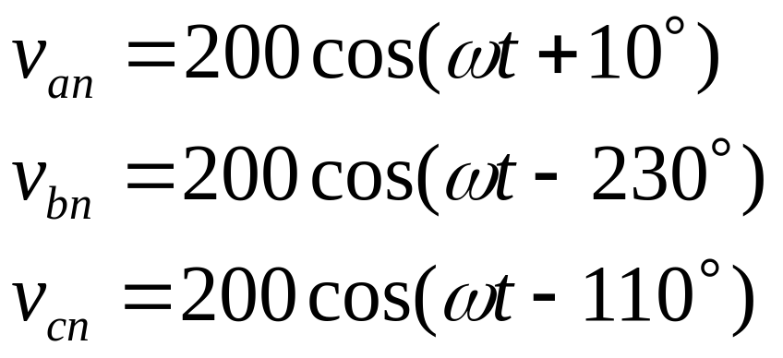
12.2 Balance Three-Phase Voltages (4)
Example 1
Determine the phase sequence of the set of voltages.

Slide 10
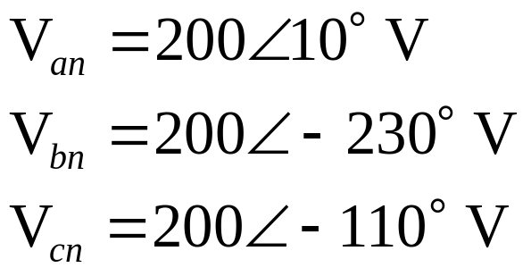
12.2 Balance Three-Phase Voltages (5)
Solution:
The voltages can be expressed in phasor form as
We notice that V_{an} leads V_{cn} by 120° and V_{cn} in turn leads V_{bn} by 120°.
Hence, we have an acb sequence.

Slide 11
12.3 Balance Three-Phase Connection (1)
Four possible connections
    Y-Y connection (Y-connected source with a Y-connected load)
    Y-Δ connection (Y-connected source with a Δ-connected load)
    Δ-Δ connection
    Δ-Y connection

Slide 12
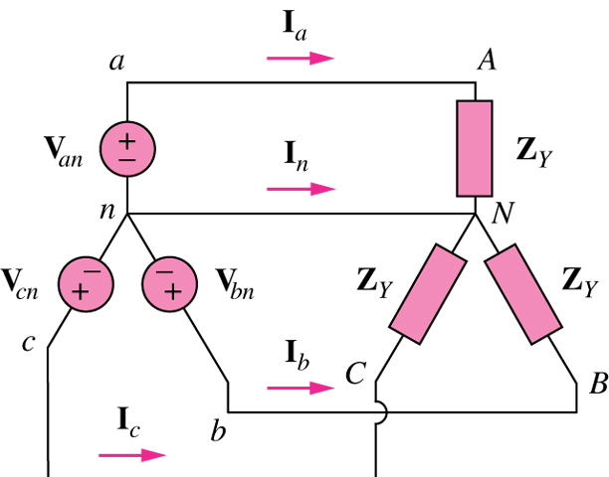
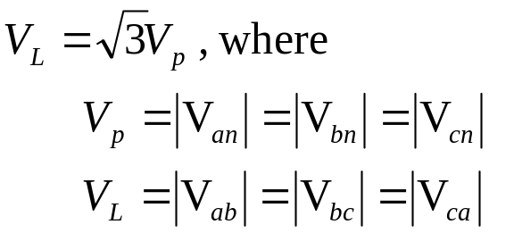
12.3 Balance Three-Phase Connection (2)
A balanced Y-Y system is a three-phase system with a balanced y-connected source and a balanced y-connected load.

Slide 13
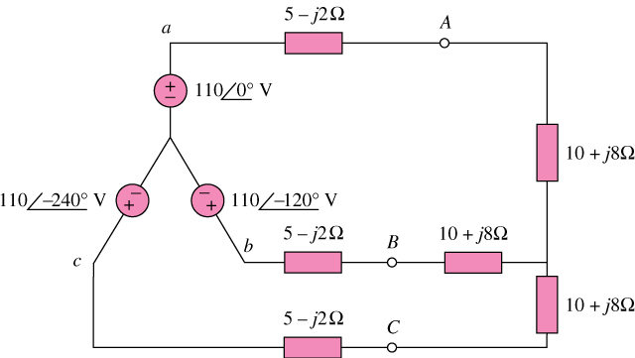
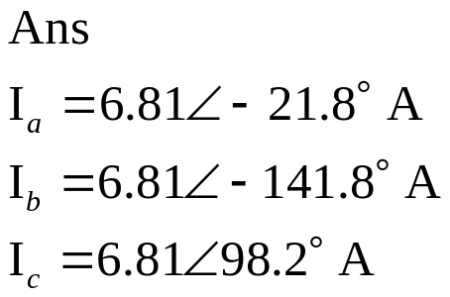
12.3 Balance Three-Phase Connection (3)
Example 2
Calculate the line currents in the three-wire Y-Y system shown below:
*Refer to in-class illustration, textbook

Slide 14
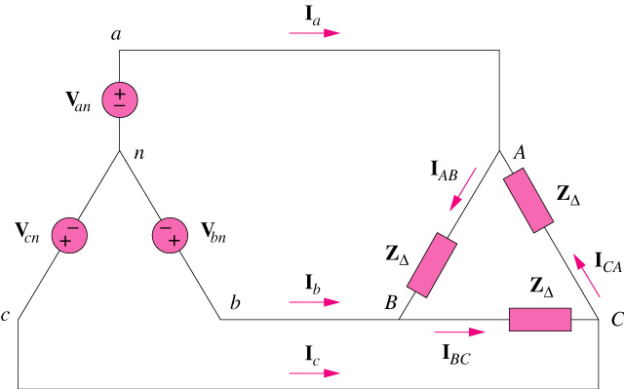
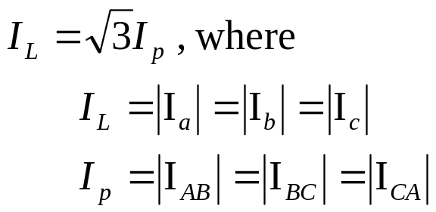
12.3 Balance Three-Phase Connection (4)
A balanced Y-Δ system is a three-phase system with a balanced y-connected source and a balanced Δ-connected load.

Slide 15

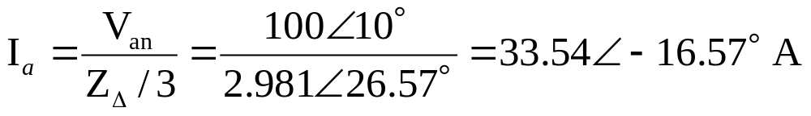
12.3 Balance Three-Phase Connection (5)
Example 3
A balanced abc-sequence Y-connected source with ( ) is connected to a Δ-connected load (8+j4)Ω per phase. Calculate the phase and line currents.
Solution
Using single-phase analysis,
Other line currents are obtained using the abc phase sequence
*Refer to in-class illustration, textbook

Slide 16
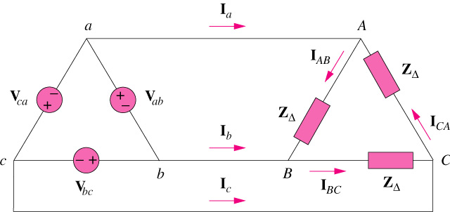
12.3 Balance Three-Phase Connection (6)
A balanced Δ-Δ system is a three-phase system with a balanced Δ -connected source and a balanced Δ -connected load.

Slide 17

12.3 Balance Three-Phase Connection (7)
Example 4
A balanced Δ-connected load having an impedance 20-j15 Ω is connected to a Δ-connected positive-sequence generator having ( ). Calculate the phase currents of the load and the line currents.
Ans:
The phase currents
The line currents
*Refer to in-class illustration, textbook

Slide 18
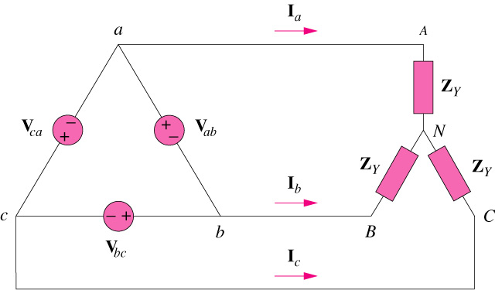
12.3 Balance Three-Phase Connection (8)
A balanced Δ-Y system is a three-phase system with a balanced y-connected source and a balanced y-connected load.

Slide 19
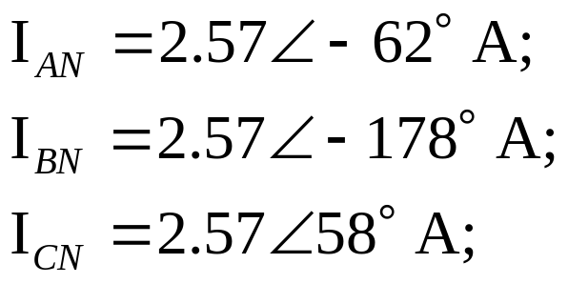
12.3 Balance Three-Phase Connection (9)
Example 5
A balanced Y-connected load with a phase impedance 40+j25 Ω is supplied by a balanced, positive-sequence Δ-connected source with a line voltage of 210V. Calculate the phase currents. Use V_{ab} as reference.
Answer
The phase currents
*Refer to in-class illustration, textbook

Slide 20
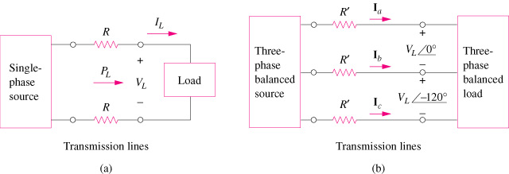
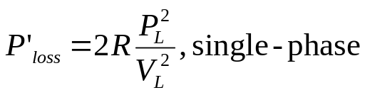
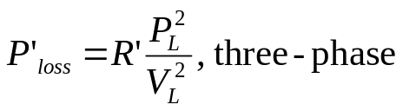
12.4 Power in a Balanced System (1)
Comparing the power loss in (a) a single-phase system, and (b) a three-phase system
If same power loss is tolerated in both system, three-phase system use only 75% of materials of a single-phase system

Slide 21
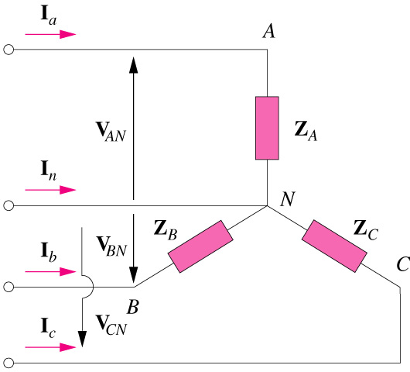
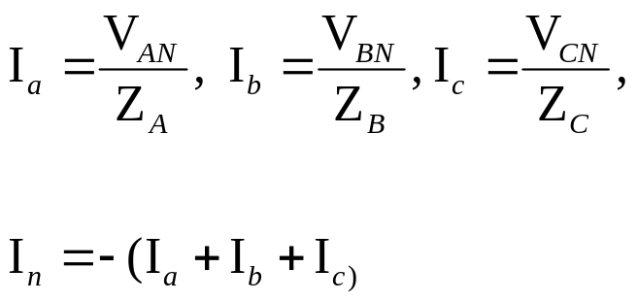
12.5 Unbalanced Three-Phase Systems (1)
An unbalanced system is due to unbalanced voltage sources or an unbalanced load.
To calculate power in an unbalanced three-phase system requires that we find the power in each phase.
The total power is not simply three times the power in one phase but the sum of the powers in the three phases.

Slide 22
12.3 Unbalanced Three-Phase Systems (2)
Example 6
Determine the total average power, reactive power, and complex power at the source and at the load
Ans
At the source:
S_{s} = -(2087 + j834.6) VA
P_{a} = -2087W
P_{r} = -834.6VAR
At the load:
S_{L} = (1392 + j1113) VA
P_{a} = 1392W
P_{r} = 1113VAR
*Refer to in-class illustration, textbook

Slide 23
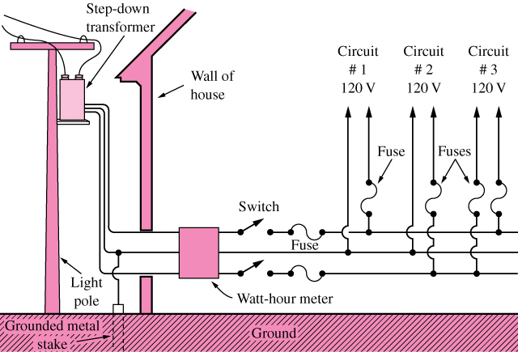
12.6 Application – Residential Wiring (1)
A 120/240 household power system

Slide 24
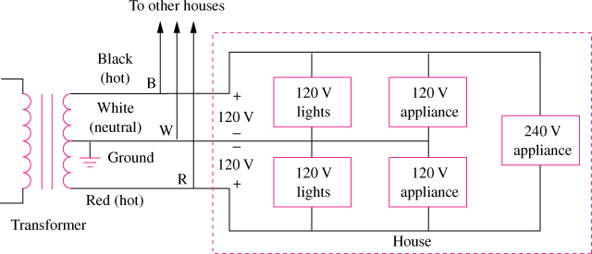
12.6 Application – Residential Wiring (2)
Single-phase three-wire residential wiring

Slide 25
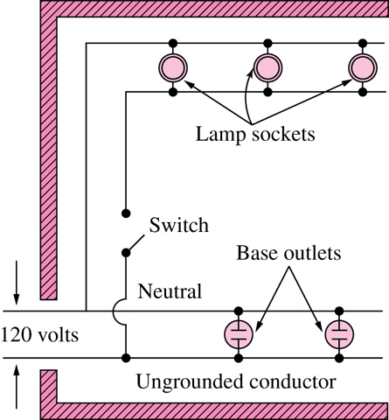
12.6 Application – Residential Wiring (3)
A typical wiring diagram of a room

